Slide 2
Background
Learned from Bill Carson
Multiple All American relay teams
Coached World Junior championship relay teams
As coach
had several conference champion 4x100’s
Coached ncaa ranked relays, Penn relay champions

Slide 3
Blind handoffs
Used for 4x100, 4x200
Different variations

Slide 4
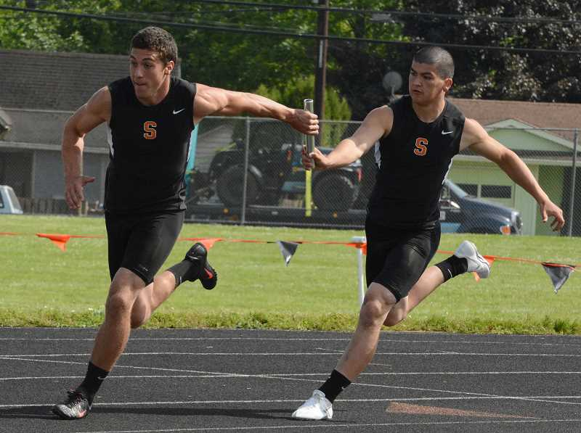
The Bill Carson style

Slide 5
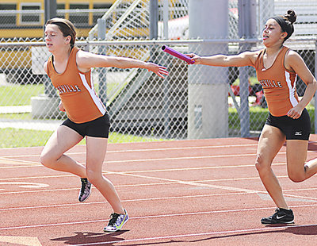

Slide 6
How it works
Set up marking 17 steps back (12/5 if possible)
When incoming runner hits “box” outgoing runner takes off
Outgoing runner takes off, on 5th step extends hand out and slightly back, just below shoulder width
Palm should be flat, thumb pointed down
Incoming runner extends forward and “sticks” the baton into hand
Incoming runner responsible for hitting target (“no reaching”)
Outgoing runner is responsible for “taking” it from incoming runner
(we did not use verbal queues, only visual)

Slide 7
Which hand should runner carry stick in?
Lead off runner carries baton in right hand (outside hand)
2nd leg takes it in left hand (inside hand)
3rd leg takes/carries baton in right hand (outside hand)
4th leg takes it in left hand (inside hand)

Slide 8
Advantages
Safe yet effective
Physically easier to exchange, less chance for moving target
Incoming runner can come in full tilt with no fear of running into next runner

Slide 9
Practicing
Use ¾ speed to practice mechanics
Once mechanics are set, use full speed to adjust distances
This requires proper rest between reps
Incoming runners should be going 60m-70m when bringing it in, similar to race
Outgoing runner should go 40m-50m when taking it out
Start with safe distances, extend as team grows comfortable

Slide 10
4x100 strategies
Different philosophies
Most dependable/ best starter leads off
Best runner should be 2nd or 4th leg (adjust so these legs are longer)
3rd leg needs to be a curve runner
We once put slowest leg last!

Slide 11
Keep it simple
Keeping the handoffs simple will:
Minimize the stress on the runners
Allow them to focus on their running without fear
Create a system where you can easily interchange other runners into your relay, or reorder the team with minimal practice

Slide 12
Adjusting for 4x200m relay
Shorten the take off zones accordingly
Incoming runners will not be coming as fast in 4x200

Slide 13
Open Hand offs
Used for 4 x 400m, 4 x 800m relays
Take handoff in left hand, switch to right
When runner approaches
Outgoing runner takes 3 steps
Turns and takes handoff while looking
Outgoing runner “takes” baton

Slide 14
Strategies
When runner takes baton
Sprints 30m-50m to establish position
Settles into rhythm
Avoid urge to “get it all back”

Slide 15
