Slide 1
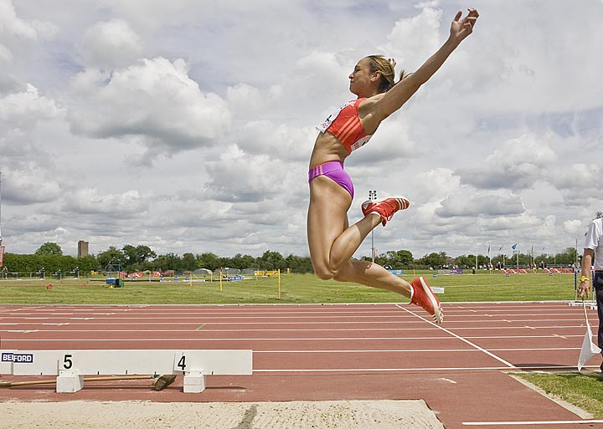
Long Jump

Slide 2
Long Jump
Basically a sprint rather than a jump
Must generate speed at take off
Consistency is a key

Slide 3
Preseason
Lots of sprinting, and drills
We work on stride pattern before we ever get to the runway
Run 8-10 approaches on the track
Start from consistent point
Put tape down where takeoff foot hits
Number the tape to determine pattern as athlete gets fatigued
When athlete is fairly consistent (70% within 6-10 inches) move to runway

Slide 4
Long Jump - approach
Start
First 2 steps are key to consistent length of approach
1st phase is getting up to speed
2nd phase getting to top end speed
3rd phase – maintain and prepare for take off

Slide 5
Take off
Final few steps are “steering”
Maintain stride and speed
Avoid chop steps
Avoid looking at board
Use arms to gain acceleration
“Long-Short” for final 2 strides
Drop hips slightly then rise on takeoff
Avoid “sailing” to reach board
Body position is key, not foot position on board

Slide 6
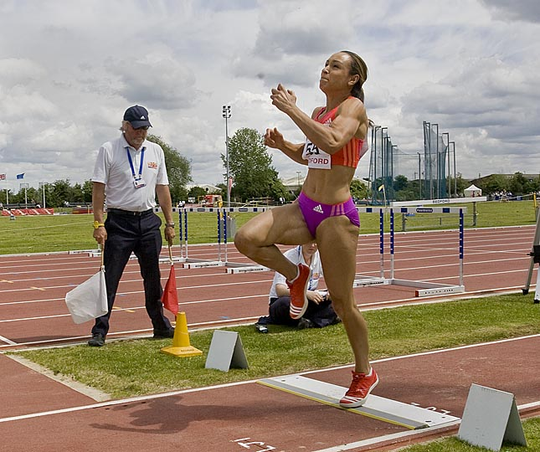

Slide 7
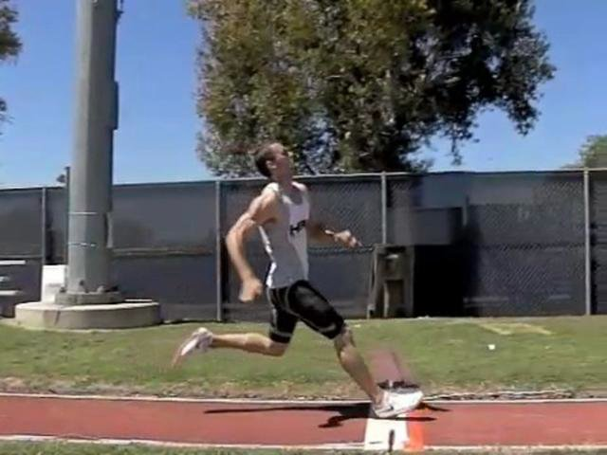
Poor body position

Slide 8
Take off
Drive knee and opposite arm up, 45 degree angle
Stay tall
Run off the board
Thrust hips

Slide 10
Flight
Hang vs Running
Don’t over rotate, use arms to counter balance

Slide 11
Landing
Kick out to the side

Slide 12
Summary
Most important aspects
Speed of Approach
Body position at takeoff

Slide 13
Triple JumP
Hop, Step Jump

Slide 14
Phase 1
Approach is similar to that of Long jump, but with a little bit more control
No long-short step
Run off the board
Bring jump leg around in circular motion (like a single leg bound)
Important to get foot back up underneath the hips
Avoid reaching, it does not gain any distance for body
Reaching takes you out of position and kills momentum

Slide 15
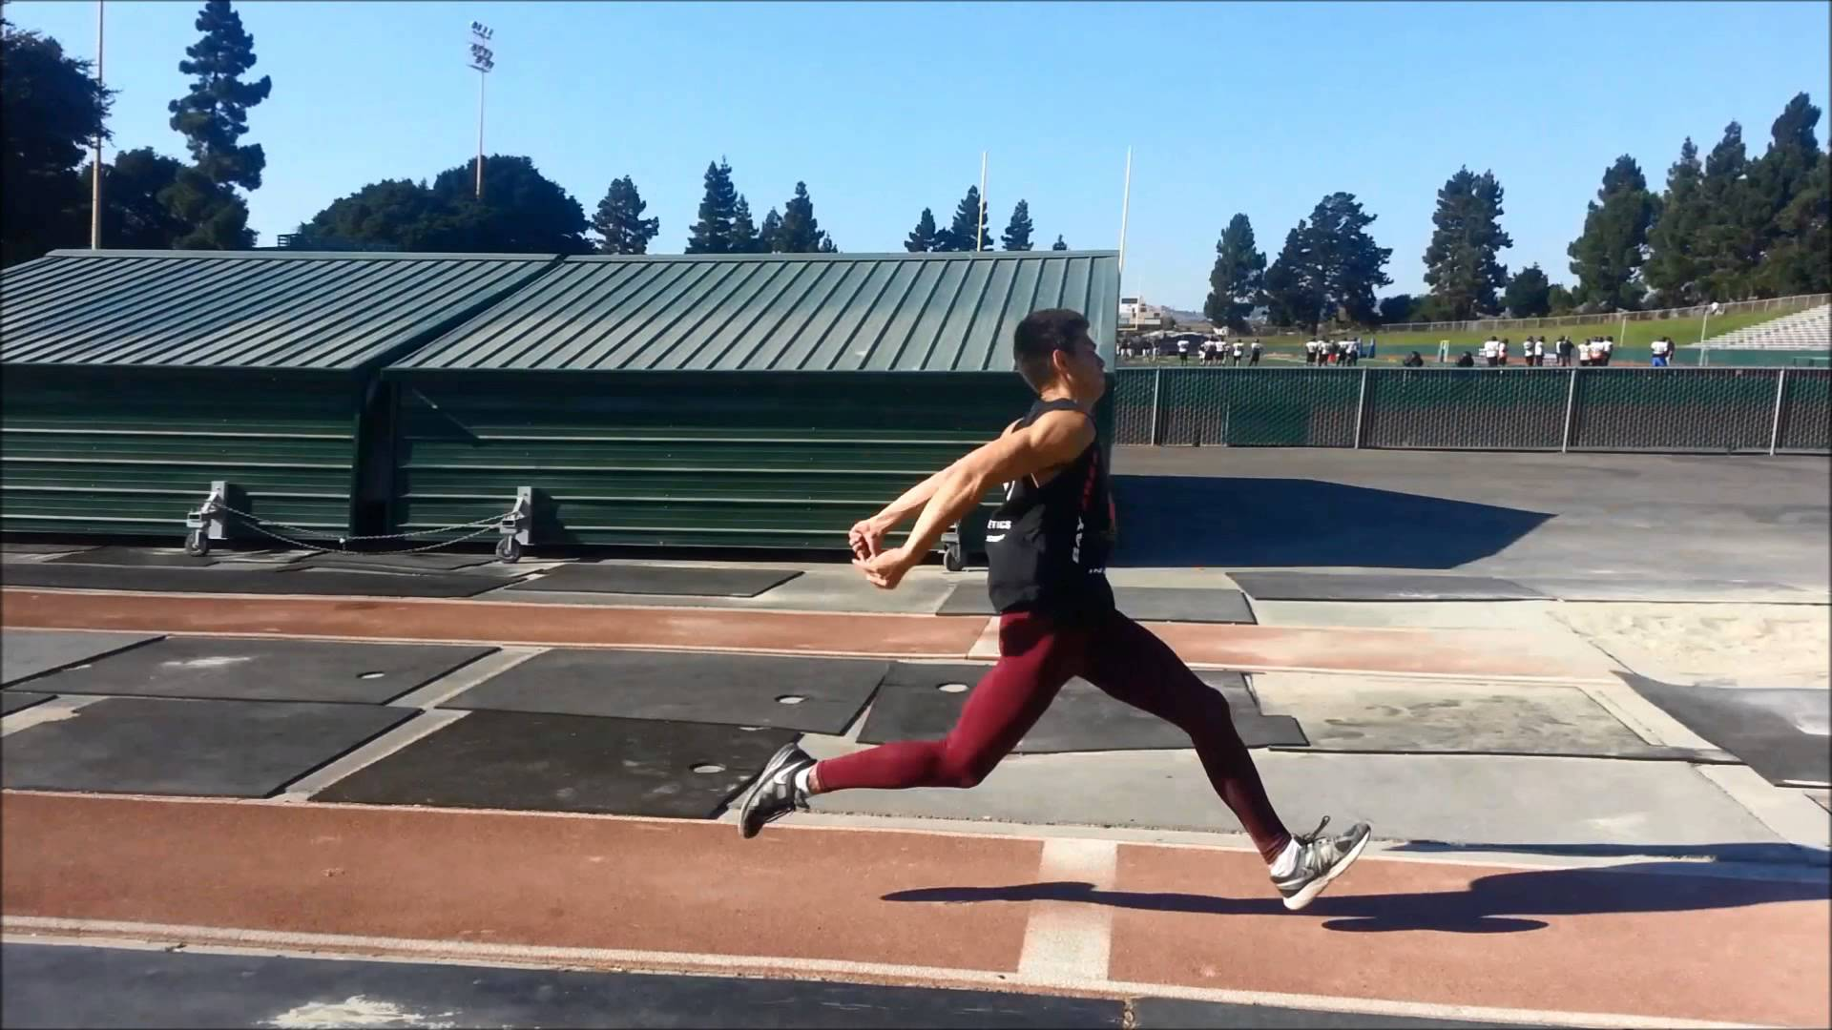
Poor foot position

Slide 16
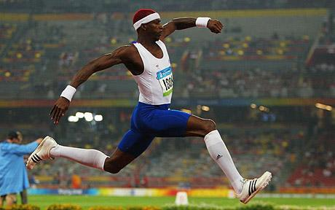
Notice the bent knee – good position!

Slide 17
Phase 2-Step
Nice long step
Keep momentum forward, not up
Get foot back underneath the hips
Arms swing is important (double arms)

Slide 18
Landing phase
This is almost like long jump
Going for 45 degree takeoff
Foot underneath hips
Use arms, drive up and attempt long jump landing

Slide 19
Training
Lots of bounding and plyo’s
Hurdle hops
Hurdle step overs to work hip flexors
Bound on grass, save the shins!
Explosiveness is gained by using arms
Must have strength in order to control the speed

Slide 20
Philosophy
Develop consistent approach
Avoid too much speed until technique is solid
Practice by shortening the phases in practice to improve technique

Slide 21
High Jump
Must use speed of approach to generate height
Start slow, finish fast!
Bounding to get leg strong
Lots of flexibility work
Use arms
Jump up

Slide 22
Drills
Single leg box jumps
Hurdle hops
Core strength is a must
Sprints are important

