Slide 1
Coaching Sprinters

Slide 2
Mechanics
Arms control the legs
90 degree angles
Drive elbows back
swinging at shoulder (not elbow)
Run tall
slight lean forward
Hips over knees
Step over your knees

Slide 3
Start/Drive phase
Drive-Phase Position • Keep chest down and out in front of body • Stay in line • Preserve good shin angle—shin back and behind driving knee

Slide 4
Max-Speed Position
• Stand tall and form a right angle with chest and lead leg,
at front thigh is parallel to the ground • Step over knee with opposite foot • To prevent overstriding, keep lead foot behind and underneath lead knee • Strike ground with foot behind center of gravity. Do not use butt-kick-style leg motion

Slide 5
Stick Runs
You need 20 flat 18”x4” sticks or strips of tape.
Place one every five feet in a ladder formation down the track.
Beginning five meters in front of the first stick, run forward.
Upon reaching the first stick, sprint over the row of sticks, adhering to proper max speed mechanics so you perform one stride for each stick.
Have a coach or teammate time each sprint over the sticks. Walk back to the start and repeat for the specified reps.

Slide 6
Sets/Reps/Rest: 2x5; rest 5 minutes between sets Progression: Perform twice a week, adhering to distance progression below.
Weeks | First 5 Sticks | Second 5 sticks | Third 5 Sticks | Fourth 5 Sticks
1-2 | 5’ | 5’ | 5’ | 5’
3-4 | 5’ | 5’ | 5’ 6” | 5’ 6”
5-6 | 5’ | 5’ 6” | 6’ | 6’
7-8 | 5’ 6” | 6’ | 6’ | 6’6”

Slide 7
Coaching Point:
Strike the ground and pull your foot back into position quickly.
As the distance between the sticks grows—and thus the distance of the entire sprint gets longer—you should be able to cover the sticks in the same time as before.
If you are unable to hit your time, go back to five feet between all sticks and repeat the progression.

Slide 8
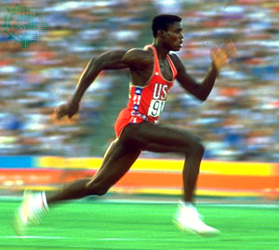
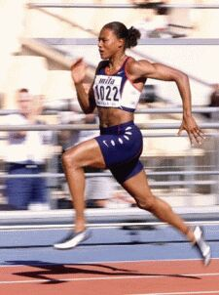

Slide 9
Coach Frye says:
This is a forced mechanic, as you are compelled to bring your knee up and pull your foot up to step over the next stick.
Over time, this teaches a runner to lengthen his stride while keeping the same frequency.
There are two elements to increasing speed—stride length and stride frequency. Improving just one of those will make you faster.

Slide 10
Acceleration sticks
Acceleration Patterning (100CM+10CM spacing for additional stick) 1) 100 cm 2) 210 cm 3) 330 cm 4) 460 cm 5) 600 cm 6) 750 cm 7) 910 cm 8) 1080 cm 9) 1260 cm 10) 1450 cm
This teaches gradual opening of stride, improves turnover

Slide 11
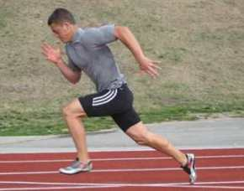

Slide 12
Flying 40s
Perform a run-up for 30 yards, then run at max speed for another 40 yards.
Have a coach or teammate time the max speed portion. Walk back to the line and repeat for the specified reps.
Sets/Reps/Rest: 2x5; rest 3 minutes between sets

Slide 13
Breathing pattern
Exhale for 20m
Inhale for 20m
Repeat for 100m-200m total
Place cones along track for visual queues
Run ¾ speed to perfect patterns and develop habit

Slide 14
Hills
Short sprints up inclines
Great for emphasizing sprint mechanics
Sprints down slight inclines
great for turnover & stride length
The hill can not be too steep, only slight decline

Slide 15
Understand conditioning
Early season
More reps, shorter recoveries, lower quality
This will condition the sprinters
As season progresses
Longer recoveries, less reps, increase quality
Late season
Highest quality speed
Lots of rest & recovery
Fewer reps

Slide 16
Training for short sprints
Flying 40’s
In & Outs (50m stride-50m sprint-50m stride)
adjust distance as needed
Drills (skips, fast feet, hurdle step overs, arm drills)
Full Speed Starts (requires lots of recovery)
Condition in spikes
On grass
X’s (run diagonals, jog ends)
200’s with diagonal walk back to start

Slide 17
UCLA workout
This is a controlled effort
100-100-100
100-100-200-100
100-200-200-100
100-200-100-100
100-100-100
Recovery
jog back 50m after each 100
Jog back 100m after each 200
Jog back 100m after each set

Slide 18
Late season training
Faster, higher quality
More recovery
Emphasis on full speed efforts

Slide 19
400m training
Lots of reps with short bits of recovery
Examples
3 or 4 300’s at controlled pace with 2 min recovery
4 x 100m with 30-40 sec rest, repeat 3- 4 times with extra rest between sets
All work should be done at pace where good form can be maintained
Okay to get good rest between sets

Slide 20
Sample week-early season
Monday – conditioning or high quality
Tuesday – starts, relay handoffs
Wednesday – race
Thursday – easy conditioning day
Friday – high quality day, strength day

Slide 21
Sample week – late season
Monday – full efforts, lots recovery, relay work,
Tuesday – starts, light drills
Wednesday – race
Thursday – light conditioning to work out soreness
Friday – intense sharpening workouts
Split 400’s, all out 50’s, all out 150’s
Lots of rest
Starts

Slide 22
Warm up cards
Hurdle step overs
Resistance runs
Keep good form

